Slide 1
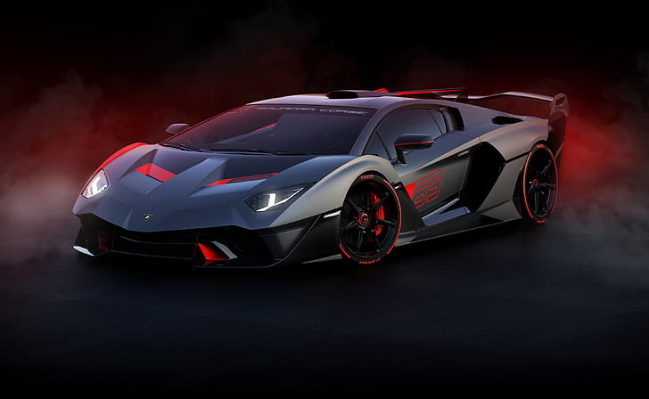
Car Price Prediction
By Prateek AP

Slide 2




Introduction

Slide 3

Introduction
With the covid 19 impact in the market, we have seen lot of changes in the car market. Now some cars are in demand hence making them costly and some are not in demand hence cheaper. One of our clients works with small traders, who sell used cars.
With the change in market due to covid 19 impact, our client is facing problems with their previous car price valuation machine learning models. So, they are looking for new machine learning models from new data.
We have to make car price valuation model. This project contains two phase
Data Collection Phase
Model Building Phase

Slide 4
Problem Statement

Slide 5
Data Collection Phase
In Data Collection phase we have used selenium for scrapping the data of about nearly 18,000 records of cars in different cities.
Data includes features like brand, model, variant, manufacturing year, driven kilometers, fuel, number of owners, location and at last target variable Price of the car.
we have scrapped the data of used cars from carwale.com
The data which we obtained from this website was in Raw format so we will be cleaning the data that we got in later stages.

Slide 6
Data Modelling Phase
In data modelling phase we will be using different machine learning models to build a model which predicts the price of the car
the complete life cycle of data science includes the following steps:
data cleaning
exploratory data analysis
data pre-processing
model building
model evaluation
selecting the best model

Slide 7
Initial Understanding of the data
There are no null values in the dataset.
There are duplicate records which would have to be removed .
The dataset is a mixture of categorical and continuous features, where in target variable is continuous.
Since the target feature is of the type continuous, this is a Regression Problem
There are outliers in some features which will have to be handled.
There is skewness in some features which needs to be treated.
We have lot to work on Data preprocessing since the data is obtained from scrapping and is in Raw format.

Slide 8
Tools Used
Tools Used
Python(Jupyter Notebook)
NumPy
Pandas
Sklearn
Matplotlib
Seaborn
Regression Models
Ensembling Technique
GridSearchCV (Hyperparameter Tuning)

Slide 9
Data Preprocessing

Slide 10
Data Pre-processing
Loading Dataset
Finding null values.
Data Visualization
Finding Skewness
Finding Outliers
Feature Engineering
Feature Engineering

Slide 11
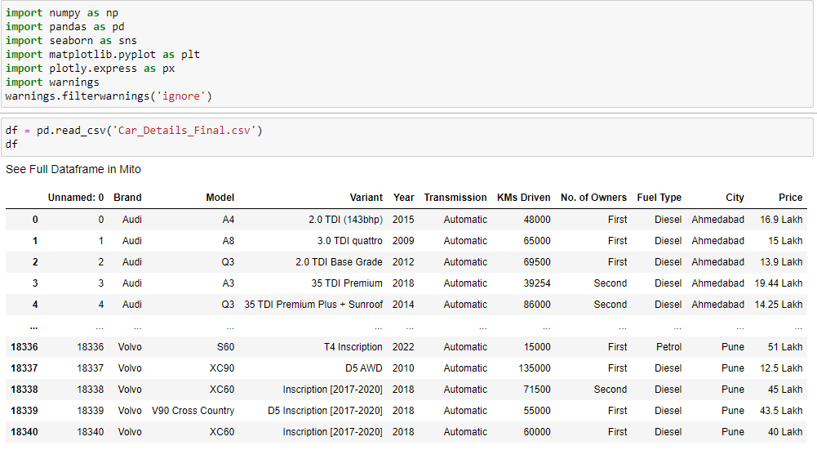
Pre-Processing
Importing the necessary libraries
Importing the data

Slide 12
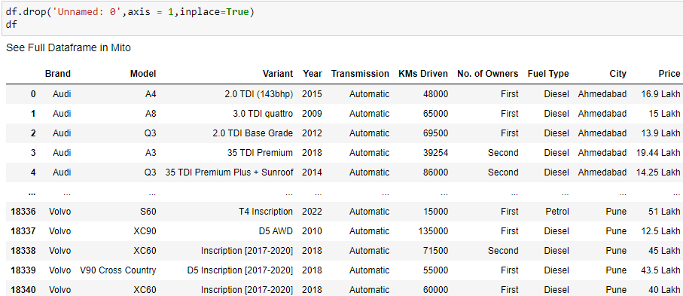
Pre-processing
Column : Unnamed: 0
Let's drop this as it does not add any value to the model.

Slide 13
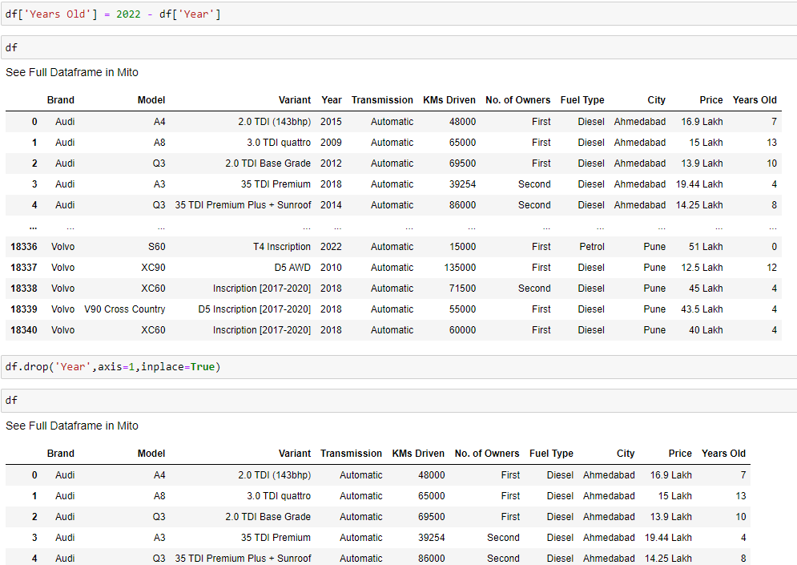
Pre-processing
Column : Year
Year on its own would not make a lot of sense, lets extract a new feature stating how old the car is.
Later drop year.

Slide 14
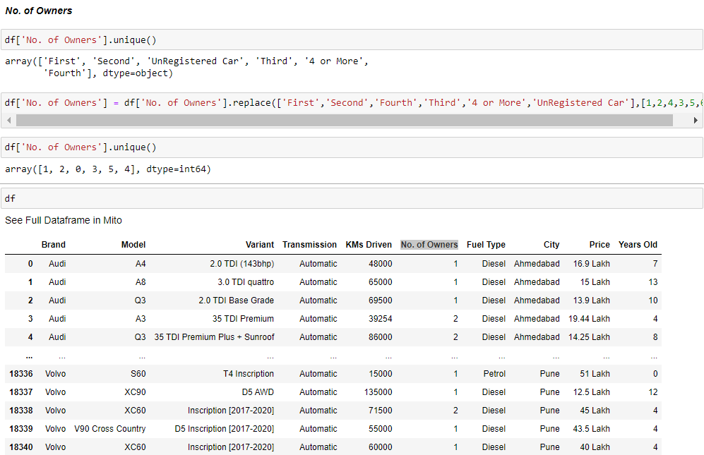
Pre-processing
Column : No. of Owners
No. of Owners is in alphabetical form, let's map them to its numeric equivalents.

Slide 15
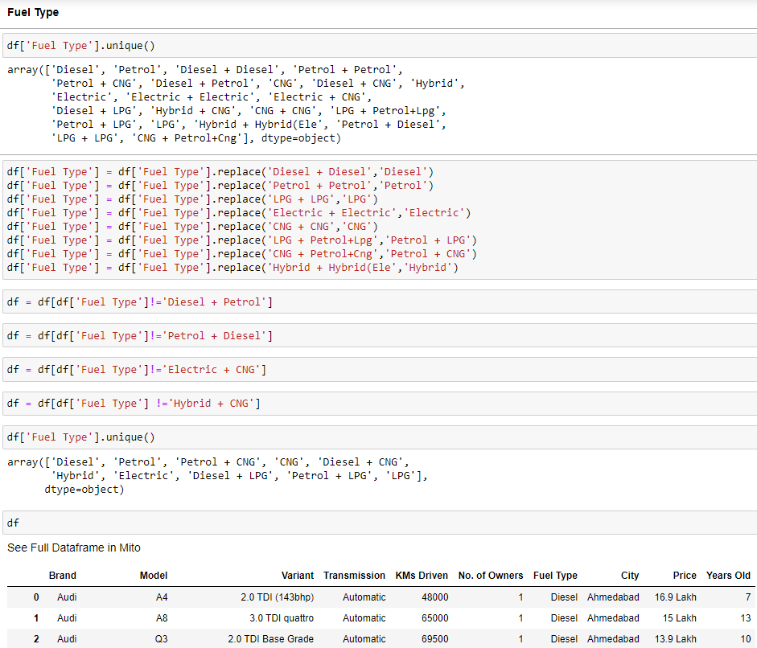
Pre-processing
Fuel Type
Fuel type has a few sub categories such as petrol +diesel but such cars do not exist. So, let's get rid of them.

Slide 16
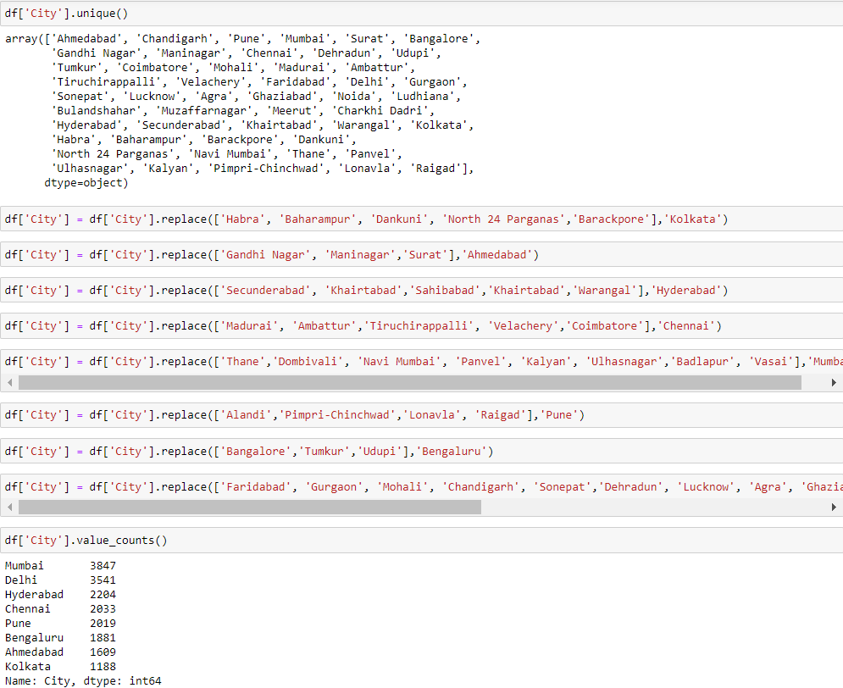
Pre-processing
City
We've scrapped the data for 8 cities but have some values for neighboring cities as well. Let's map them to the target 8 cities based on the location.

Slide 17
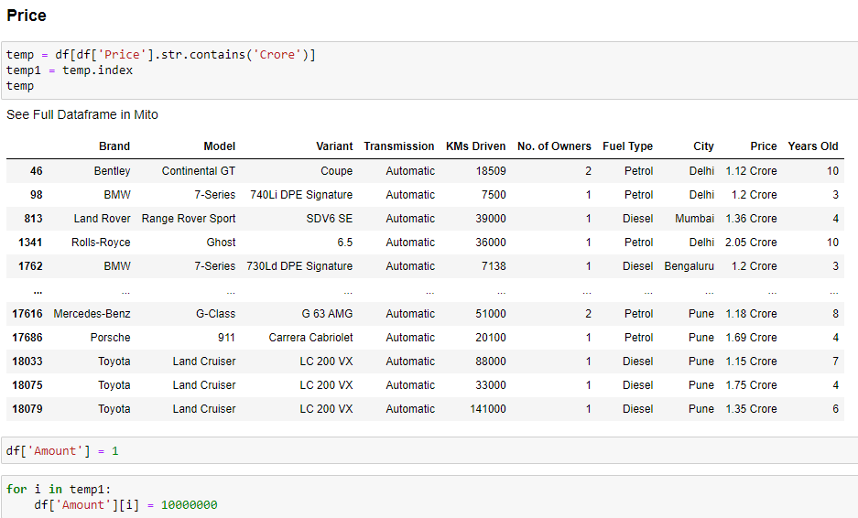
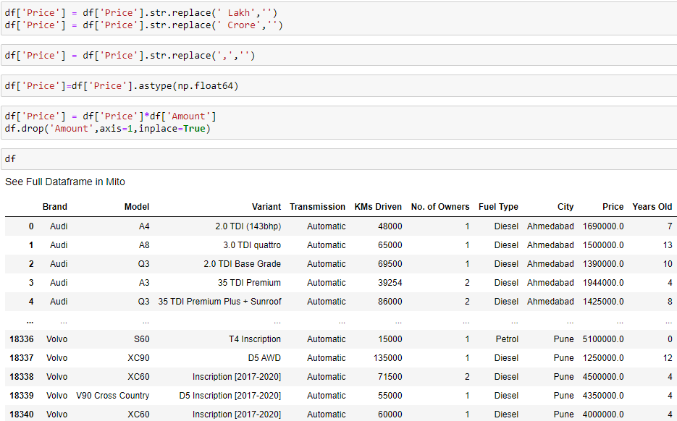
Pre-processing
Price
The price is in lakh's and crores. Let's map it to its equivalent numeric values.

Slide 18
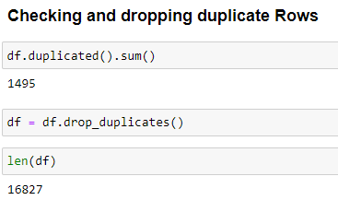
Pre-processing
Checking Duplicate Row's and dropping them

Slide 19
Visualization

Slide 20
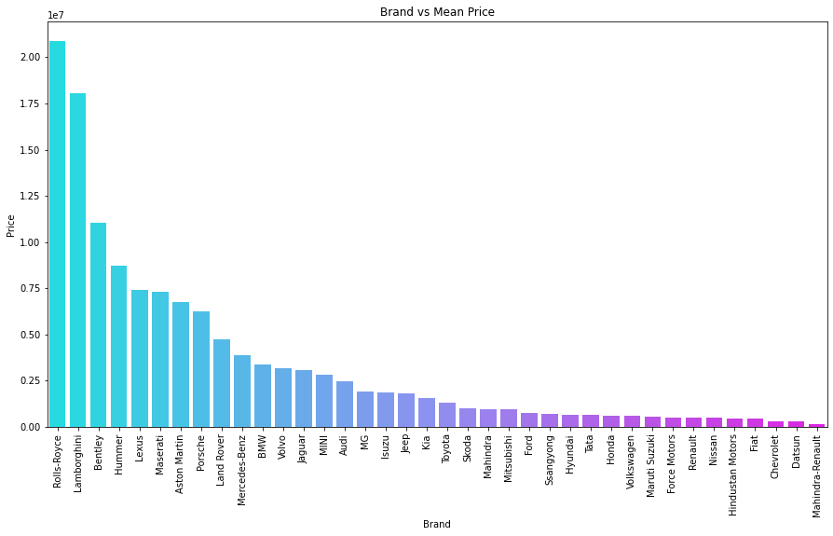
Visualization
We see the mean price wise distribution of the brands.
Rolls-Royce are the most expensive.
Mahindra-Renault is the cheapest.

Slide 21
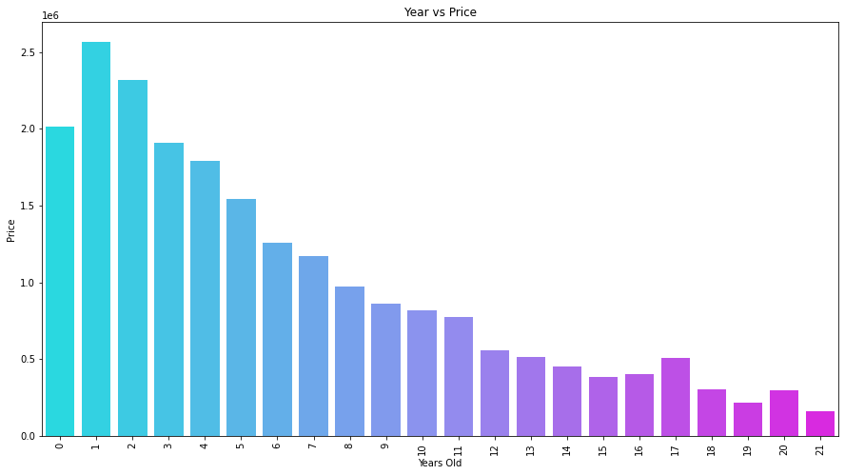
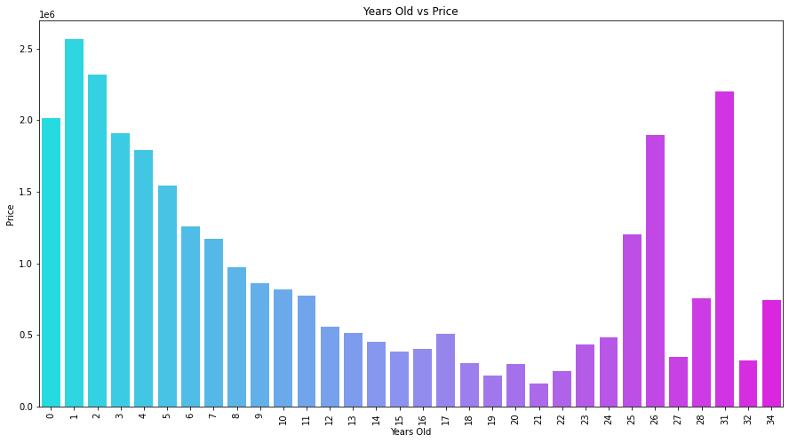
Visualization
We see a linear relation in the cars that are up to 23 years old.
On further analysis we see that there are just 15 cars sold which are higher than 24 years old, which also happen to be mostly exotic cars because of which the avg price has a very high peak.
We could drop them as it would affect our model adversely.

Slide 22
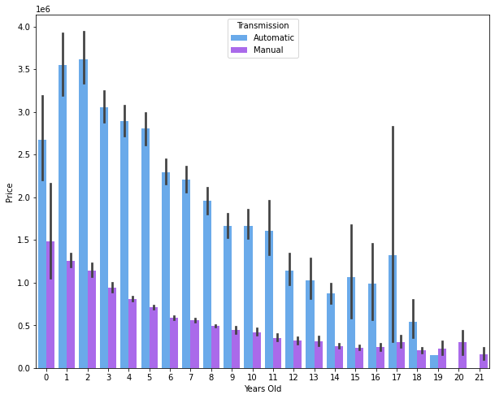
Visualization
We see that the prices of Automatics are significantly higher than the Manuals.

Slide 23
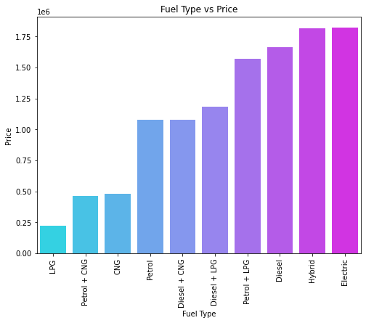
Visualization
We see that the Hybrid and Electric vehicles are the most expensive.

Slide 24
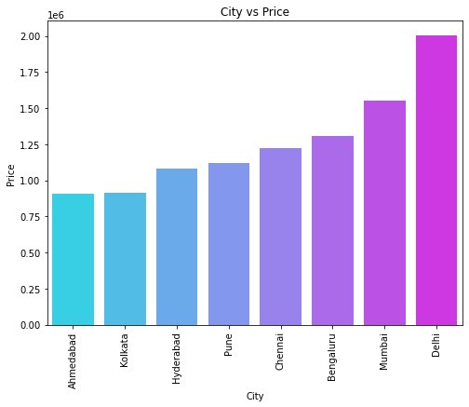
Visualization
We see that the vehicle cost in Ahmedabad is the Cheapest and Delhi the highest.

Slide 25
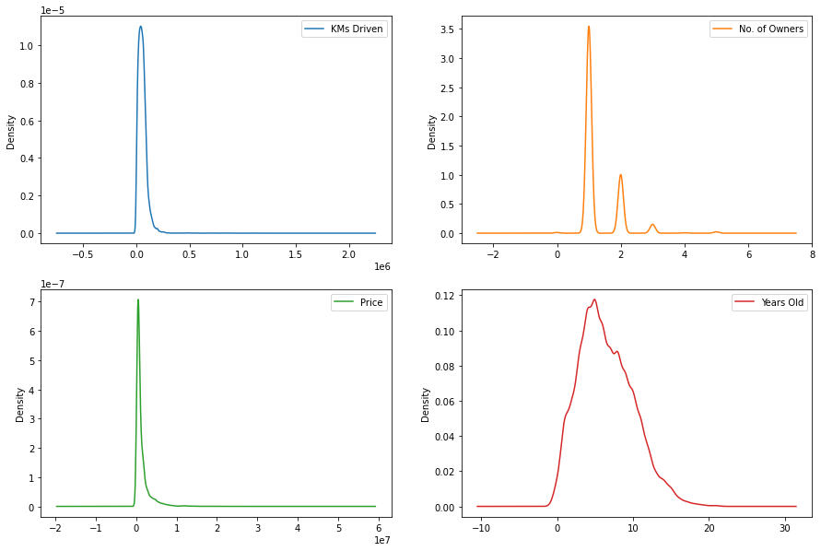
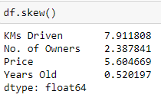
Visualization
Checking Skewness:
Setting the skewness threshod as +/-0.5.We see right skewness in the data.
- KMs Driven - No. of Owners - Price
The above mentioned features are above the skewness threshold but No. of Owners and Price can be ignored No. of Owners is a categorical variable and Price is Target Variable.

Slide 26
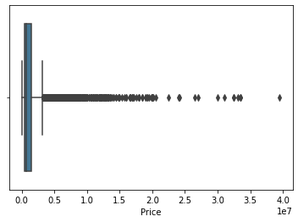
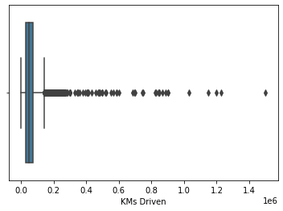
Visualization
Checking Outliers
We see a lot of outliers in the price and KM's driven.

Slide 27
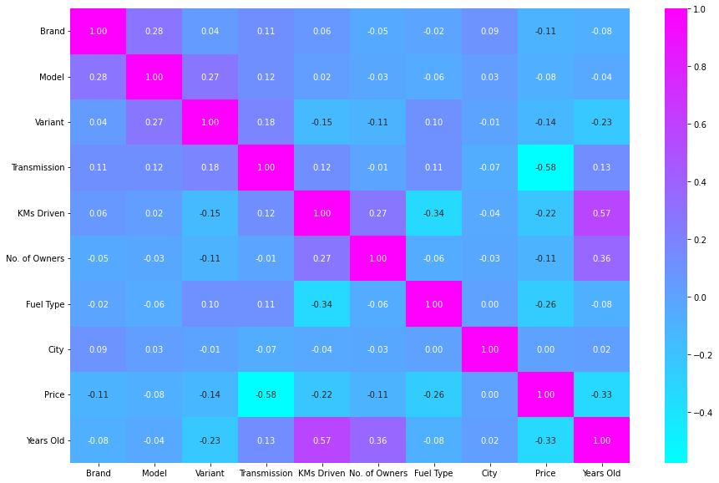
Visualization
Checking Correlation:
We see Transmission has the highest negative correlation with the Target.
Most of the features are negatively correlated and City has 0 correlation, Hence we could consider dropping it.

Slide 28
Data Modeling

Slide 29
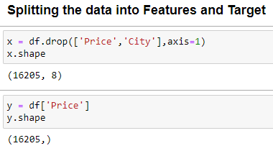
Data Modeling
Splitting the data into Features and Target

Slide 30
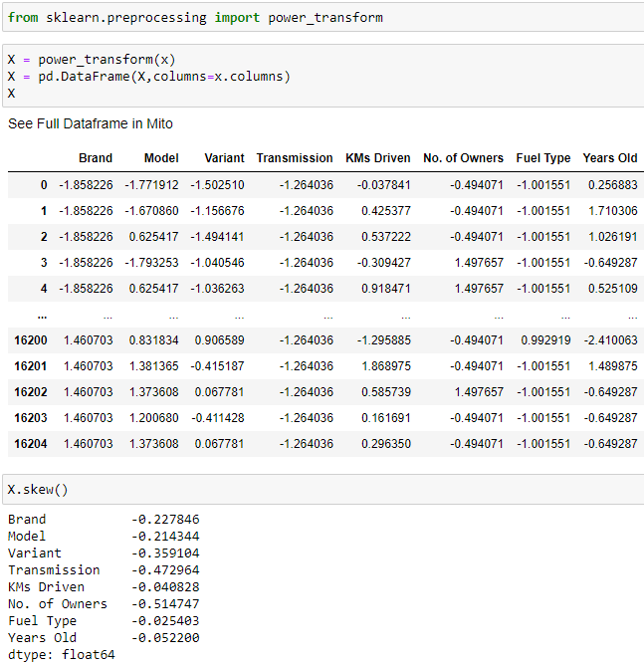
Data Modeling
Normalizing the Data
Rechecking for skewness if it's in threshold

Slide 31
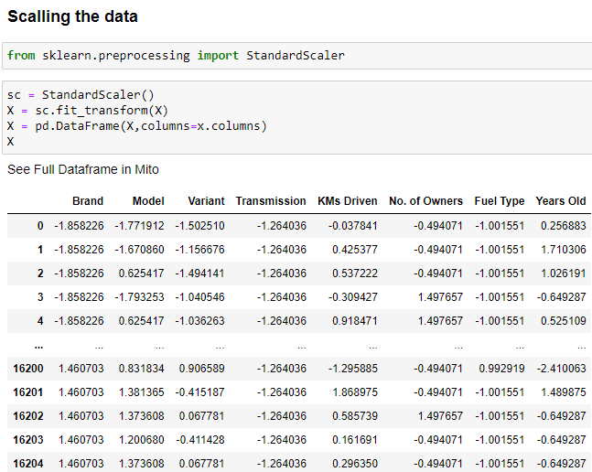
Data Modeling
Scaling the data

Slide 32
Model Building

Slide 33
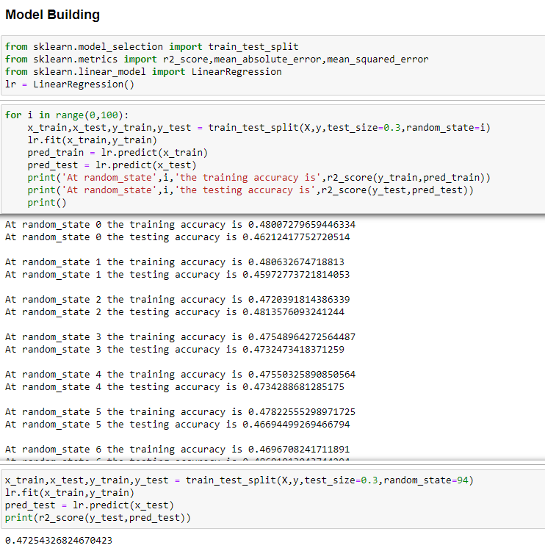
Model Building
Importing necessary libraries
Finding the best random state

Slide 34
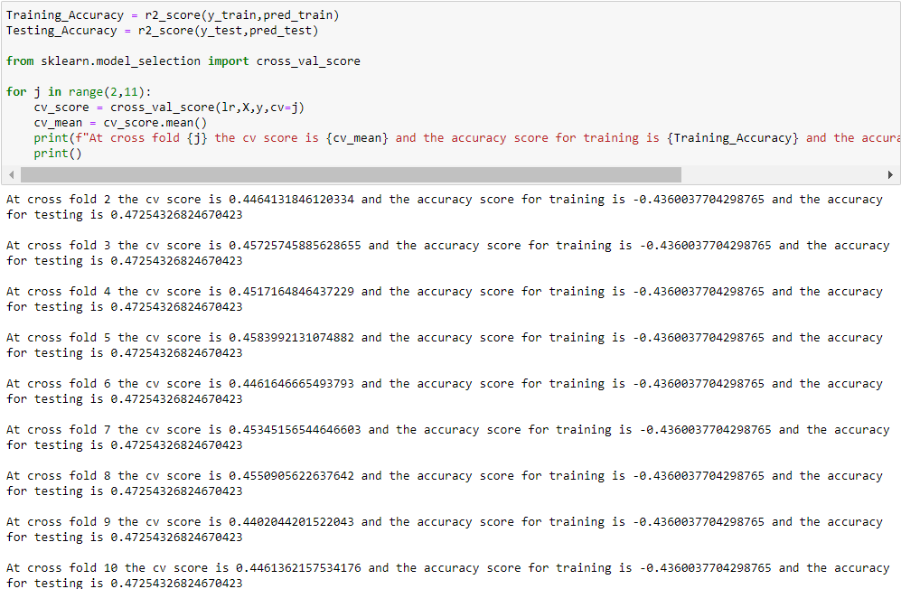
Model Building
Finding best k-folds for cross-validation

Slide 35
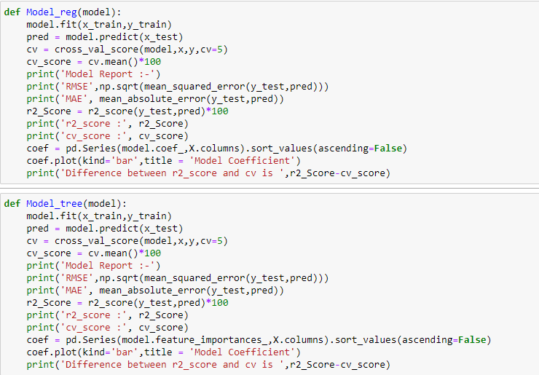
Model Building
Defining Linear Models and Tree based Models.

Slide 36
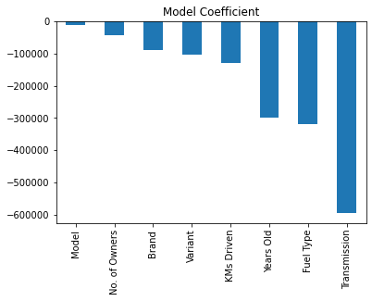
Model Building
Linear Regression:
Model Report :- RMSE 913636.8880079273 MAE 598672.448471305 r2_score : 47.25432682467042 cv_score : 45.73828222628279 Difference between r2_score and cv is 1.51604459838763

Slide 37
Model Building
Ridge:
Model Report :- RMSE 913637.6731891622 MAE 598659.9907344144 r2_score : 47.254236165172905 cv_score : 45.739093776995105 Difference between r2_score and cv is 1.5151423881778001

Slide 38
Model Building
Lasso
Model Report :- RMSE 913636.9671607269 MAE 598671.9806678155 r2_score : 47.254317685442494 cv_score : 45.738288895961475 Difference between r2_score and cv is 1.5160287894810196

Slide 39
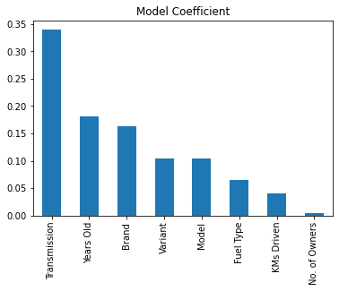
Model Building
DecisionTreeRegressor
Model Report :- RMSE 450156.669273796 MAE 205168.00397641573 r2_score : 87.19537201567415 cv_score : 83.53188978890567 Difference between r2_score and cv is 3.6634822267684797

Slide 40
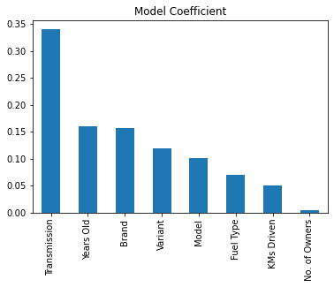
Model Building
RandomForestRegressor:
Model Report :- RMSE 345135.0408932915 MAE 166965.78865722514 r2_score : 92.47307312278703 cv_score : 90.67620534809902 Difference between r2_score and cv is 1.7968677746880104

Slide 41
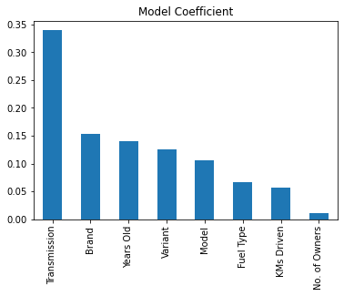
Model Building
ExtraTreesRegressor:
Model Report :- RMSE 351282.6958146908 MAE 175989.19784245166 r2_score : 92.20254096720792 cv_score : 90.27574459558106 Difference between r2_score and cv is 1.926796371626864

Slide 42
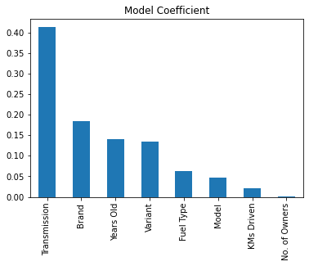
Model Building
GradientBoostingRegressor:
Model Report :- RMSE 550309.4965664748 MAE 328483.44503800396 r2_score : 80.86389247771388 cv_score : 79.18832629101288 Difference between r2_score and cv is 1.6755661867009906

Slide 43
HyperParameter Tuning

Slide 44
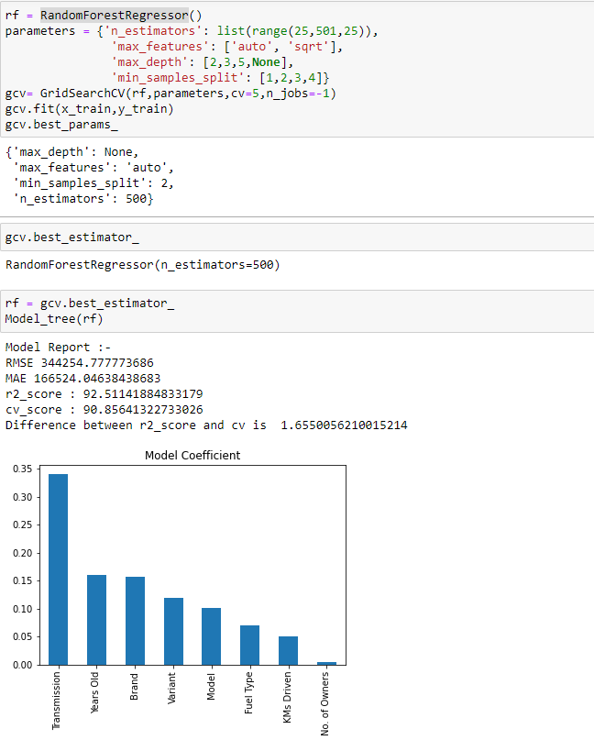
Hyperparameter Tuning
RandomForestRegressor

Slide 45
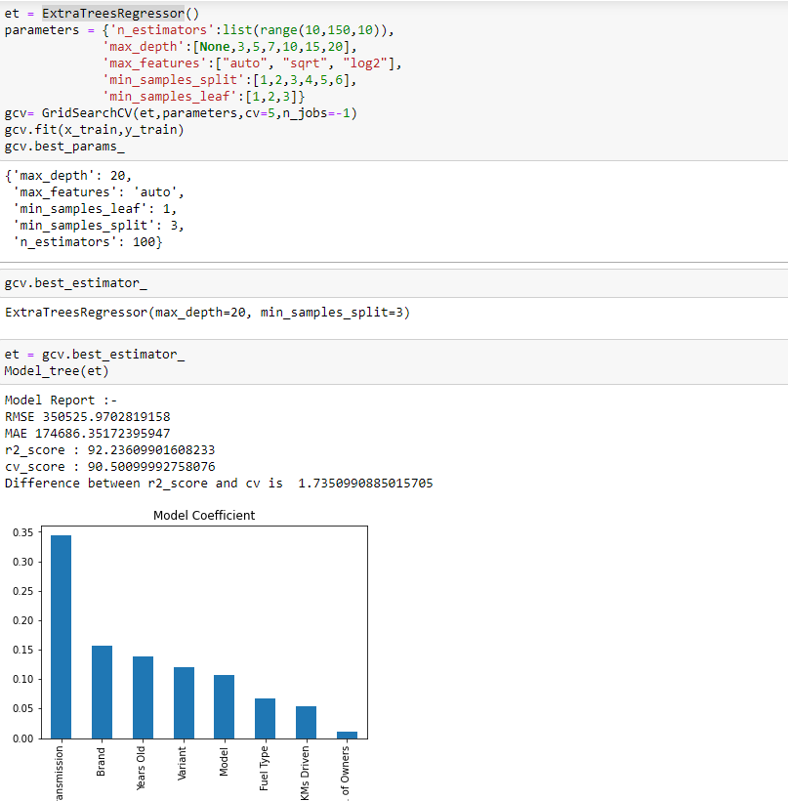
Hyperparameter Tuning
ExtraTreesRegressor

Slide 46
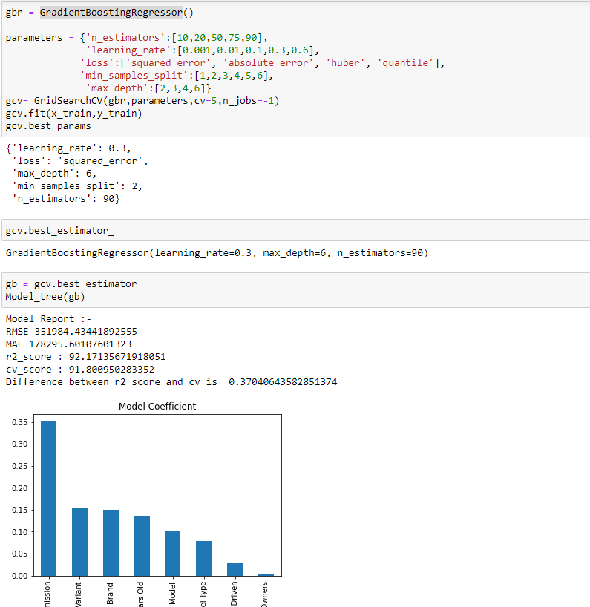
Hyperparameter Tuning
GradientBoostingRegressor

Slide 47
Final Model

Slide 48
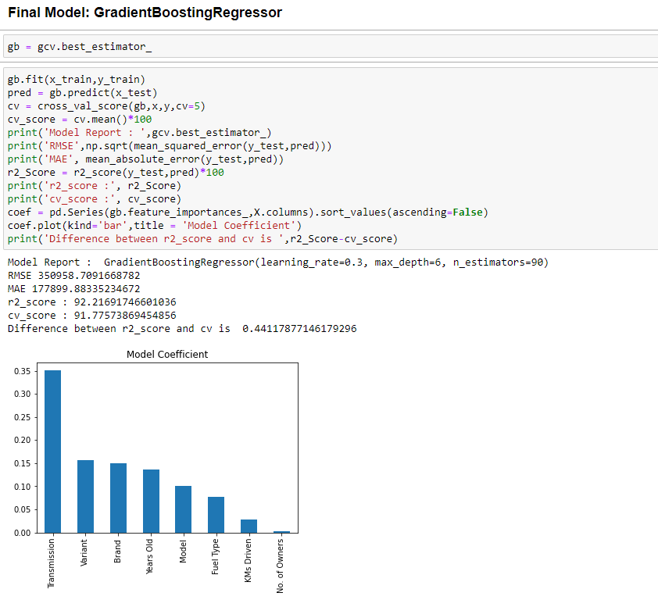
Final Model
GradientBoostingRegressor

Slide 49
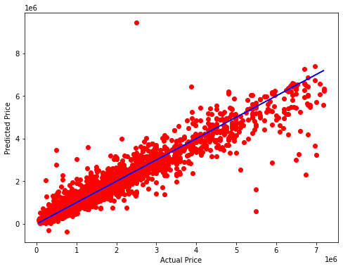
Regression plot for the model

Slide 50
Saving Best Model

Slide 51
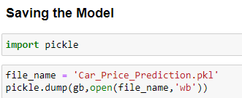
Saving the best model

